Slide 1
Chapter 12
Cryptographic
Hash Functions
12.<number>

Slide 2
MD5
MD5 was developed by Professor Ronald L. Rivest of MIT.
The MD5 algorithm] takes as input a message of arbitrary length and produces as output a 128-bit "fingerprint" or "message digest" of the input.
The input is processed in 512 bit blocks.
MD6 – the new version
    Published on 15/04/2009
    By Ronald L. Rivest
12.<number>

Slide 3
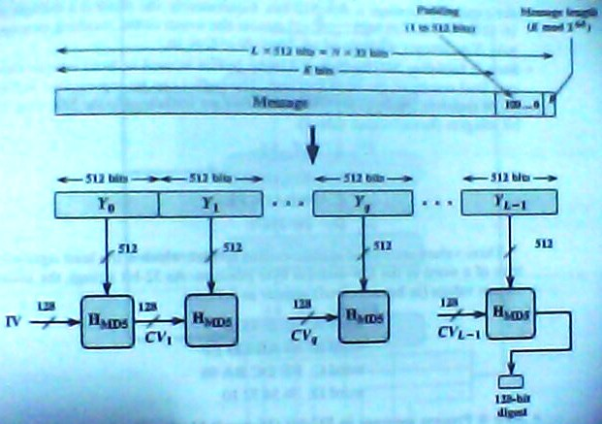
MD5 Algorithm Description
Message length
12.<number>

Slide 4
Steps:
The following five steps are performed to compute the message digest of the message.
Step 1. Append Padding Bits
Step 2. Append Length
Step 3. Initialize MD Buffer
Step 4. Process Message in 16-Word Blocks
Step 5. Output
12.<number>

Slide 5
Step-1
Append padding bits
  The message is padded so that the length in bits is congruent to 448 mod 512
  i.e. Length = 448 mod 512
  Padding consists of a 1-bit followed by necessary no of zeroes.
12.<number>

Slide 6
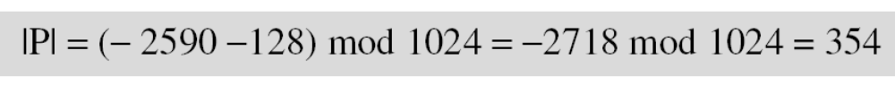
12.2.1 Continued
|M| + |P| + 64 =0 MOD 512
|P| = [-M -64] MOD 512
Example 12.3
What is the number of padding bits if the length of the original message is 2590 bits?
Solution
We can calculate the number of padding bits as follows:
The padding consists of one 1 followed by 353 0’s.
12.<number>

Slide 7
Example 12.4
Do we need padding if the length of the original message is already a multiple of 1024 bits?
Solution
Yes we do, because we need to add the length field. So padding is needed to make the new block a multiple of 1024 bits.
12.<number>

Slide 8
STEP 3
The main MD5 algorithm operates on a 128-bit state, divided into four 32-bit words,
denoted A, B, C and D.
These are initialized to certain fixed constants
In little-endian format
  i.e. least significant byte first
  Ex: if A =87654321
    The word A = 21436587
12.<number>

Slide 9
Step 4
MD5 is a compression algorithm
CV₀ = IV
CV_{q+1} = SUM₃₂[CVq, RF_{I}(Yq, RF_{H}(Yq,RF_{G}
(Yq, RF_{F}(Yq, CVq))))]
MD = CV_{L-1}
12.<number>

Slide 10
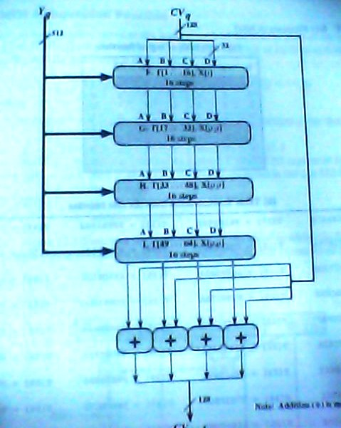

12.<number>

Slide 11
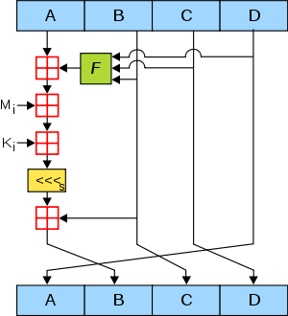
MD5 operations:
12.<number>

Slide 12
12.1.2 Two Groups of Compression Functions
1. The compression function is made from scratch.
Message Digest (MD)
2. A symmetric-key block cipher serves as a compression function.
Whirlpool
12.<number>

Slide 13
12-1 INTRODUCTION
A cryptographic hash function takes a message of arbitrary length and creates a message digest of fixed length. The ultimate goal of this chapter is to discuss the details of the two most promising cryptographic hash algorithms⎯ SHA-512 and Whirlpool.
Topics discussed in this section:
12.1.1 Iterated Hash Function
12.1.2 Two Groups of Compression Functions
12.<number>

Slide 14
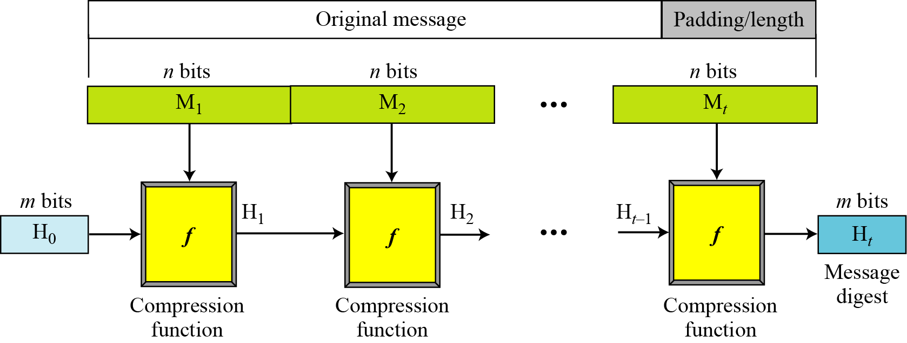
12.1.1 Iterated Hash Function
Merkle-Damgard Scheme
12.<number>
Figure 12.1 Merkle-Damgard scheme

Slide 15
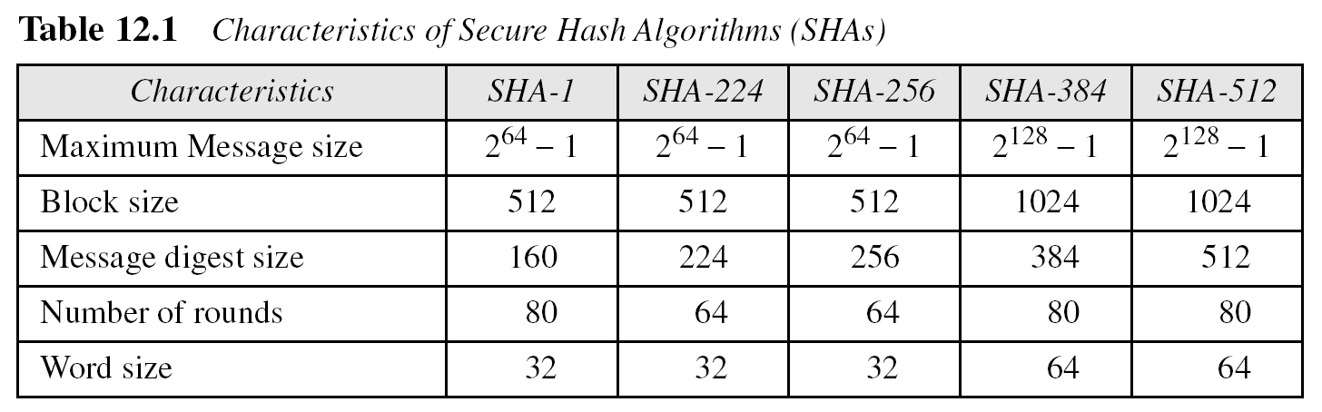
12.1.2 Continued
12.<number>

Slide 16
12-2 SHA-512
SHA-512 is the version of SHA with a 512-bit message digest. This version, like the others in the SHA family of algorithms, is based on the Merkle-Damgard scheme.
Topics discussed in this section:
12.2.1 Introduction
12.2.2 Compression Function
12.2.3 Analysis
12.<number>

Slide 17
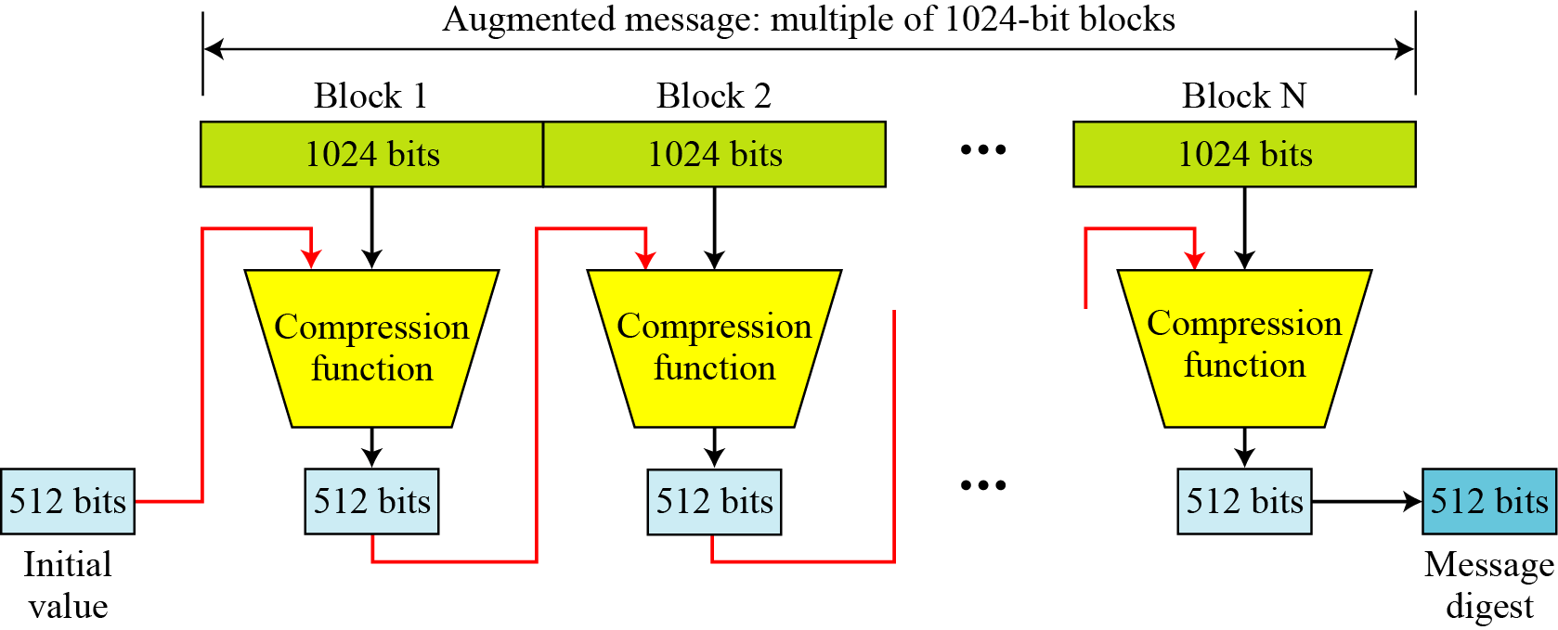
12.2.1 Introduction
Figure 12.6 Message digest creation SHA-512
12.<number>

Slide 18

12.2.1 Continued
Message Preparation
SHA-512 insists that the length of the original message be less than 2¹²⁸ bits.
Note
SHA-512 creates a 512-bit message digest out of a message less than 2¹²⁸.
12.<number>

Slide 19
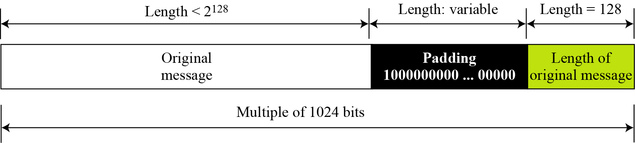
12.2.1 Continued
Figure 12.7 Padding and length field in SHA-512
12.<number>

Slide 20
12.2.1 Continued
Example 12.5
What is the minimum and maximum number of padding bits that can be added to a message?
Solution
The minimum length of padding is 0 and it happens when
(−M − 128) mod 1024 is 0. This means that |M| = −128 mod 1024 = 896 mod 1024 bits. In other words, the last block in the original message is 896 bits. We add a 128-bit length field to make the block complete.
12.<number>

Slide 21
12.2.1 Continued
Example 12.5
Continued
The maximum length of padding is 1023 and it happens when (−|M| −128) = 1023 mod 1024.
This means that the length of the original message is
|M| = (−128 −1023) mod 1024 or the length is |M| = 897 mod 1024.
In this case, we cannot just add the length field because the length of the last block exceeds one bit more than 1024. So we need to add 897 bits to complete this block and create a second block of 896 bits. Now the length can be added to make this block complete.
12.<number>

Slide 22
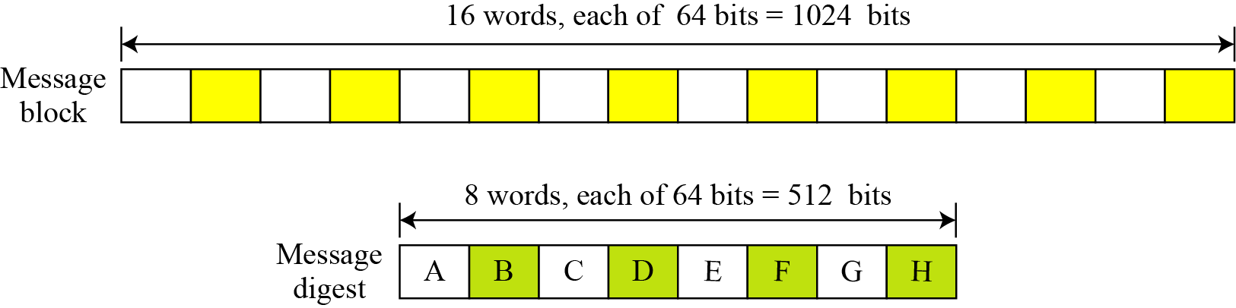
12.2.1 Continued
Words
Figure 12.8 A message block and the digest as words
12.<number>

Slide 23
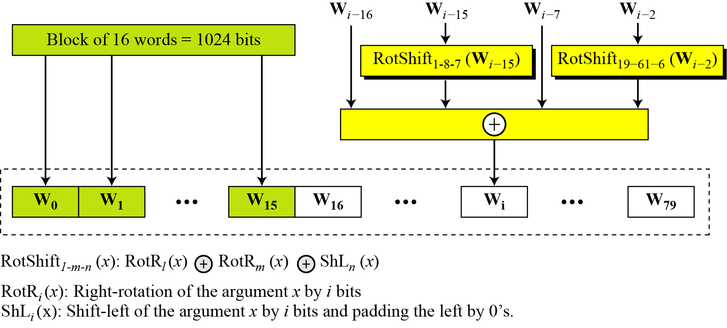
12.2.1 Continued
Word Expansion
Figure 12.9 Word expansion in SHA-512
12.<number>

Slide 24
12.2.1 Continued
Example 12.6
Show how W60 is made.
Solution
Each word in the range W16 to W79 is made from four previously-made words. W60 is made as
12.<number>

Slide 25
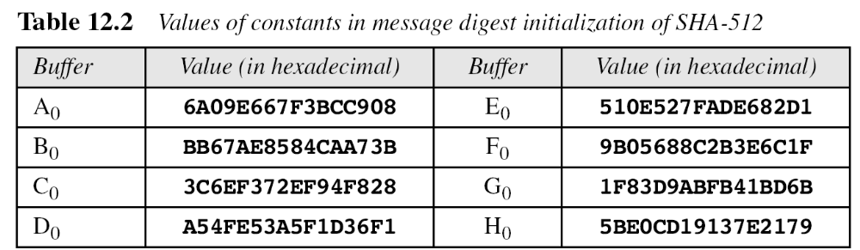
12.2.1 Continued
Message Digest Initialization
12.<number>

Slide 26
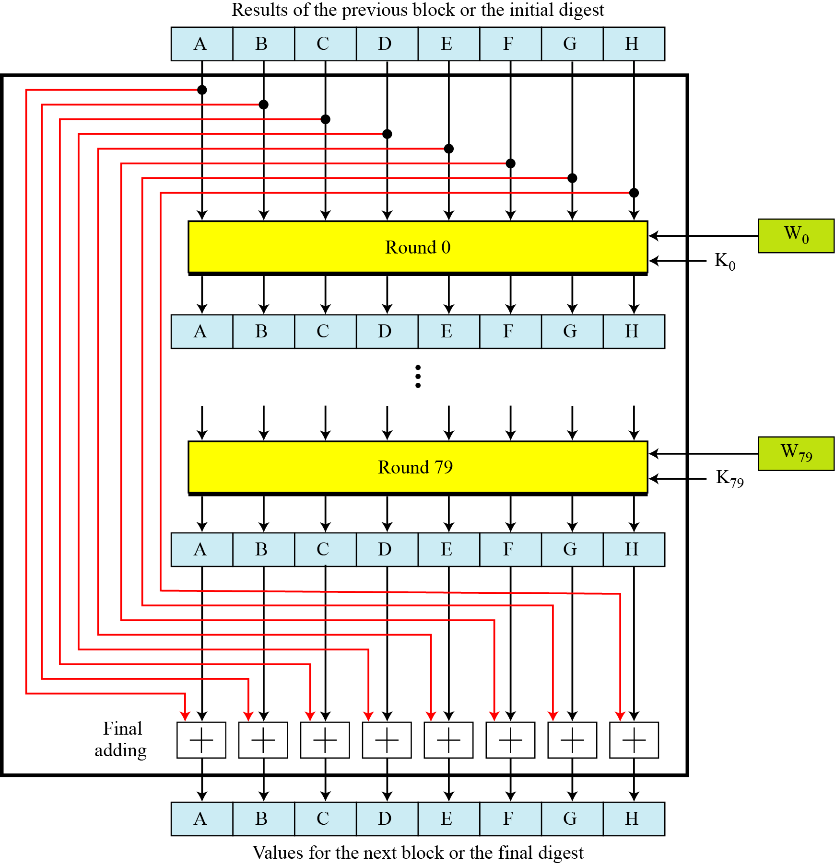
12.2.2 Compression Function
Figure 12.10 Compression function in SHA-512
12.<number>

Slide 27
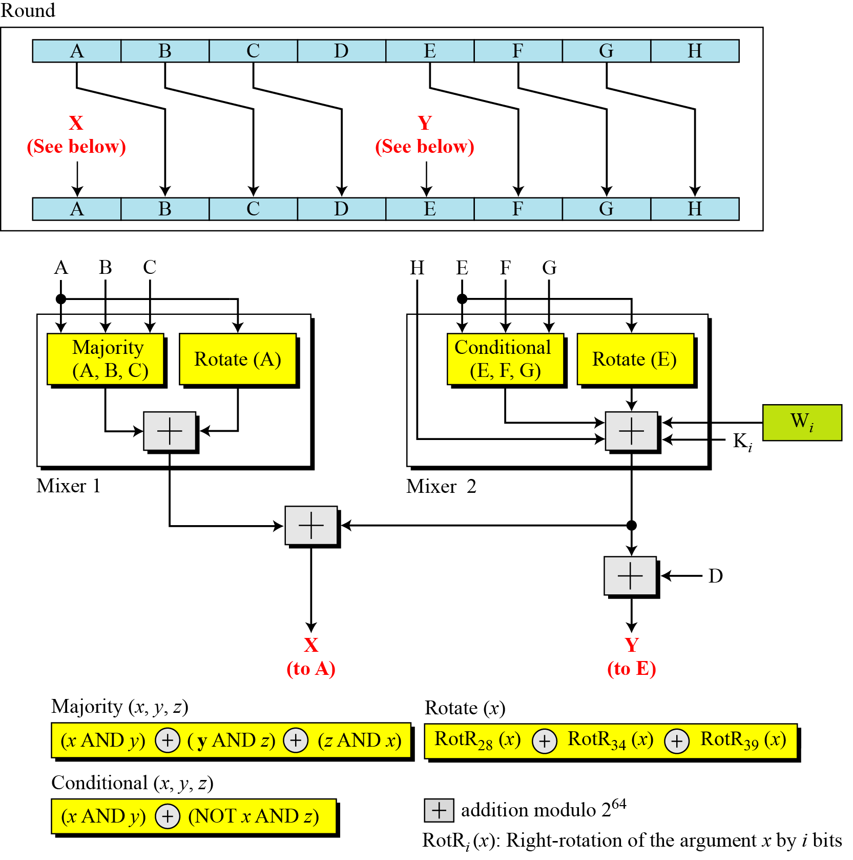
Figure 12.11 Structure of each round in SHA-512
12.<number>

Slide 28
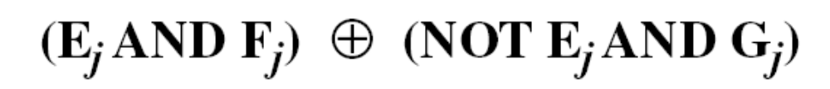
12.2.2 Continued
Majority Function
Conditional Function
Rotate Functions
12.<number>

Slide 29
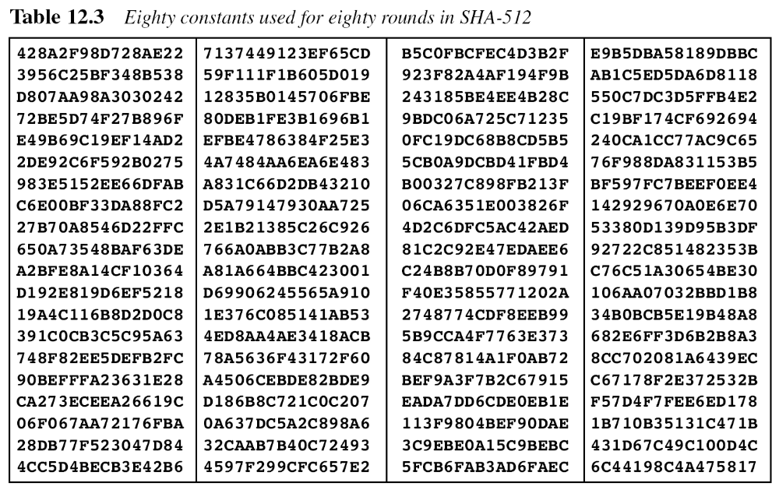
12.2.2 Continued
12.<number>

Slide 30
12.2.2 Continued
There are 80 constants, K₀ to K₇₉, each of 64 bits. Similar These values are calculated from the first 80 prime numbers (2, 3,…, 409). For example, the 80th prime is 409, with the cubic root (409)^{1/3} = 7.42291412044. Converting this number to binary with only 64 bits in the fraction part, we get
The fraction part: (6C44198C4A475817)₁₆
12.<number>

Slide 31
12.2.2 Continued
Example 12.7
We apply the Majority function on buffers A, B, and C. If the leftmost hexadecimal digits of these buffers are 0x7, 0xA, and 0xE, respectively, what is the leftmost digit of the result?
Solution
The digits in binary are 0111, 1010, and 1110.
a. The first bits are 0, 1, and 1. The majority is 1.
b. The second bits are 1, 0, and 1. The majority is 1.
c. The third bits are 1, 1, and 1. The majority is 1.
d. The fourth bits are 1, 0, and 0. The majority is 0.
The result is 1110, or 0xE in hexadecimal.
12.<number>

Slide 32
12.2.2 Continued
Example 12.8
We apply the Conditional function on E, F, and G buffers. If the leftmost hexadecimal digits of these buffers are 0x9, 0xA, and 0xF respectively, what is the leftmost digit of the result?
Solution
The digits in binary are 1001, 1010, and 1111.
a. The first bits are 1, 1, and 1. The result is F₁, which is 1.
b. The second bits are 0, 0, and 1. The result is G₂, which is 1.
c. The third bits are 0, 1, and 1. The result is G₃, which is 1.
d. The fourth bits are 1, 0, and 1. The result is F₄, which is 0.
The result is 1110, or 0xE in hexadecimal.
12.<number>

